Slide 1
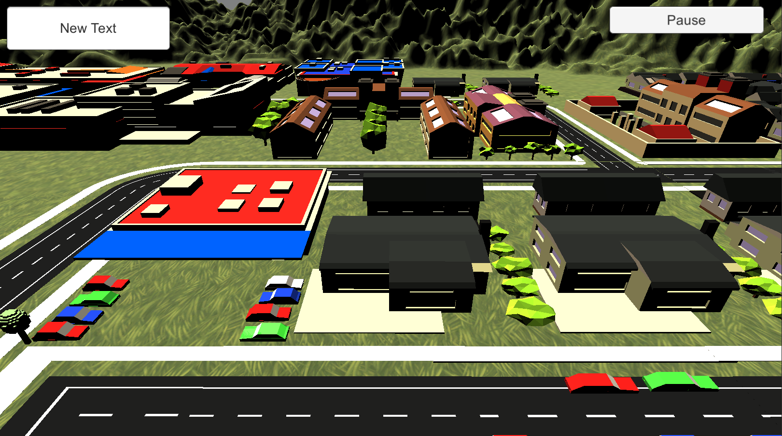









Player: Sam Score: 500

